Slide 1
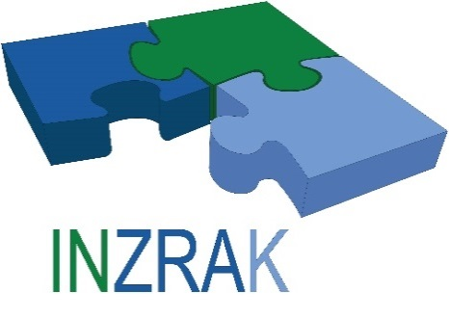





Enhanced environmental protection inspection for efficient control of air quality monitoring and of all entities under obligation within system of greenhouse gas emission allowance trading, in order to achieve better quality of air in Republic of Croatia
This project is funded by the European Union

Slide 2



Theme 3: The role of monitoring
Energy Research and Environmental Protection Institute
Mato Papić dipl. ing. stroj.
Bojan Abramović dipl. ing. stroj.

Slide 3

3.1 WHAT IS THE MONITORING OF AIR QUALITY?
The air we breathe is a necessary natural resource on which depends the life on the Earth,
Clean air is a prerequisite for a healthy lifestyle, people, animals and plants, but unfortunately, the development of the industry is continuously pollutes. So polluted the air depending on the concentrations of pollutants in it more or less has a direct harmful effects on the health of all living beings on our planet, but also indirectly, organising the water and soil,
Energy Research and Environmental Protection Institute

Slide 4
3.1 WHAT IS THE MONITORING OF AIR QUALITY?
In order to successfully work in the direction of protection of our living space, it is necessary to carry out the systematic measurement and/or assessing the levels can now witness considerable pollution according to the spatial and temporal schedule – in one word monitoring air quality.
Energy Research and Environmental Protection Institute

Slide 5
3.1 WHAT IS THE MONITORING OF AIR QUALITY?
Monitoring air quality involves a set of procedures for determination of concentration of selected air pollutants in a certain area and at a particular time.
Energy Research and Environmental Protection Institute

Slide 6
3.1 WHAT IS THE MONITORING OF AIR QUALITY?
Monitoring that includes a measurement is only one component which, together with an assessment of the risk (exposure to pollutants and health impacts) and risk management (legal regulations and development strategy), rounds off the whole in air and health protection and we call it the management of air quality (Figure 1).
Energy Research and Environmental Protection Institute

Slide 7
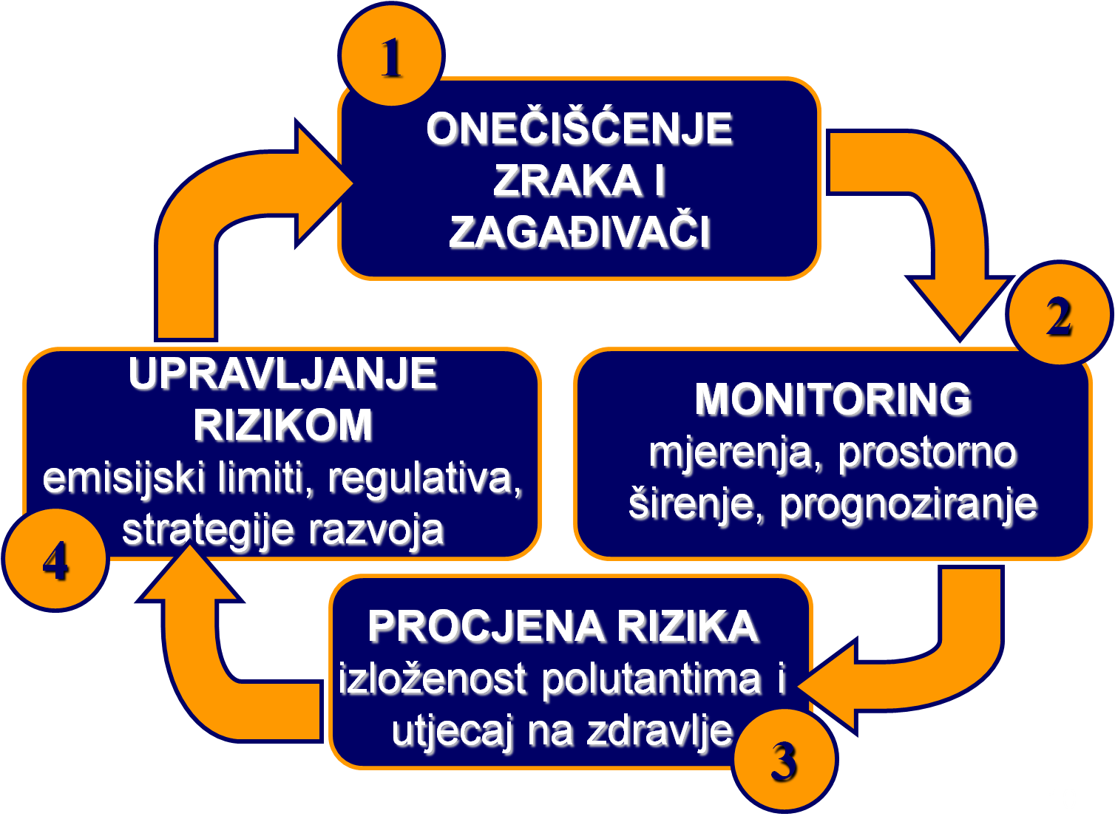
3.1 WHAT IS THE MONITORING OF AIR QUALITY?
Figure 1. The management of air quality. Source: created by author.
Energy Research and Environmental Protection Institute

Slide 8
3.1 WHAT IS THE MONITORING OF AIR QUALITY?
Monitoring is organised by setting up a network of measuring devices that continuously measure and record the concentrations of pollutants in a certain area at a certain time, and it's for exactly defined way, resulting in the possibility of comparing the results of measurements everywhere in the world.
In this way, it gets to be an insight into the State of air pollution, given the measured pollutants in a certain area.
This knowledge, other than what they are used for regulatory purposes (evaluation of air quality with regard to limit values), continue to be used in the management of air quality.
Energy Research and Environmental Protection Institute

Slide 9
3.2 RISK ASSESSMENT OF AIR POLLUTION
Exposure to contaminated the air can adversely affect human health. These effects will depend on the type of pollution with respect to:
pollutants,
the concentration of pollutants,
the duration of exposure to environmental contaminants,
the sensitivity of each individual or group.
Energy Research and Environmental Protection Institute

Slide 10
3.2 RISK ASSESSMENT OF AIR POLLUTION
The World Health Organization in its report "the WHO air quality guidelines for Europe" in annex 1.1 provides an comprehensive and documented overview of the negative effects on health caused by contaminated air.
These effects can be described concisely in a pyramid whose base are the most common and most widely prevalent effects until it is towards the top of the pyramids appear less represented effects with stronger negative impacts on health (Figure 2).
Energy Research and Environmental Protection Institute

Slide 11
3.2 RISK ASSESSMENT OF AIR POLLUTION
Figure 2. The pyramid of health effects of contaminated air. Source: "the WHO air quality guidelines for Europe".
Energy Research and Environmental Protection Institute

Slide 12
3.2 RISK ASSESSMENT OF AIR POLLUTION
In order to identify which part of the population in a specific area affected by these effects, and which, it is necessary to estimate the level of exposure of the population as a whole, as well as subgroups of the population that are particularly sensitive to air pollution is, like chronic patients and children.
Evaluating the exposure from the knowledge of the concentration of pollutants and the number of structure and movement of the population in a certain area, risk to the health of the people can be estimated.
Energy Research and Environmental Protection Institute

Slide 13
3.2 RISK ASSESSMENT OF AIR POLLUTION
Commonly accepted method for the assessment of exposure on the basis of knowledge of the levels of contamination of some pollutant is that the population in a certain area split into distinctive groups given the movement in the same space.
How the concentration of pollutants in the air are not equal at all points of a particular area, it is extremely important for assessing exposure to know which part of the population spends much of the time at which the space. Knowledge of the time stay a particular part of the population in the area with a known concentration of a particular pollutant it is possible to calculate precisely the exposure to the particular pollutant for that part of the population.
Energy Research and Environmental Protection Institute

Slide 14
3.2 RISK ASSESSMENT OF AIR POLLUTION
Table 1. shows an example of the calculation of exposure of subpopulation groups to PM10 particulates in one city with a total population of 1 000 000 inhabitants, a typical distribution of groups and typical pollution with particulates.
Energy Research and Environmental Protection Institute

Slide 15
3.2 RISK ASSESSMENT OF AIR POLLUTION
Table 1. An example of the calculation of exposure of subpopulation groups to PM10 particulates in the city of 1 000 000 inhabitants.
Energy Research and Environmental Protection Institute

Slide 16
3.2 RISK ASSESSMENT OF AIR POLLUTION
From the above examples, it is evident that there is a big difference in exposure to airborne particles in the same town with respect to:
place of residence,
employment status,
age.
By comparing such data about exposure to existing epidemiological studies, or by conducting their own epidemiological study leads to the assessment of the risk to the health of these subpopulations. If this risk is too big, ie. If represents an important public health problem, it is necessary to take measures in order to reduce this risk.
Energy Research and Environmental Protection Institute

Slide 17
3.3 RISK MANAGEMENT
Reduction of exposure of some population to contaminated air, and thus the risk of the negative effect on her health, can be achieved in two ways:
the reduction of pollution (reducing emissions of pollutants),
2. separation of the sources of pollution and residential space in which people spend the most time.
Energy Research and Environmental Protection Institute

Slide 18
3.3 RISK MANAGEMENT
Reducing emissions into the air is carried out by the introduction of new and more effective technologies in existing stationary sources and banning the construction of new stationary sources that will use the old and inefficient technologies. The best instrument for the implementation of such measures is the most common regulations. Legislation in the areas of air quality are exactly the prescribed quantities of pollutants that certain types of sources can emit to the air. Also the regulations, in case of the construction of the new sources, sets the necessity of the use of the best available technology with regard to environmental pollution. For example, without the high-quality and scientifically based study that assesses the impact of the new pollutants on the environment could not start the process of the construction of the same.
Energy Research and Environmental Protection Institute

Slide 19
3.3 RISK MANAGEMENT
Reducing exposure by separation of the sources of pollution and residential space is a very effective method, but requires a very serious approach to the urbanization and the development of society in general. Unfortunately, this method is difficult to apply to already existing problematic zones.
The problems of housing settlements in industrial zones are well known. Still from such examples such as settlements in the vicinity of the refinery and ironworks in Sisak, or artificial fertilizers factory in Kutina is necessary to draw lessons for future urban planning and development.
Energy Research and Environmental Protection Institute

Slide 20
3.3 RISK MANAGEMENT
The biggest problem in the application of these methods is a reduction in emissions from motor vehicles, since the use of the vehicle is closely associated with people's places of residence. A solution to this problem is closely connected with some very unpopular measures which decision makers do not prefer. So, it is a problem in most cases, lengthy and difficult to solve.
By raising the awareness of citizens about the problem in a reasonable period of time may lead to acceptance and of such measures.
Energy Research and Environmental Protection Institute

Slide 21
3.3 RISK MANAGEMENT
The implementation of measures to reduce health risks caused by air pollution leads to the need for re-determination of the effects of these measures.
Of course, that can be done in a good way only with air quality monitoring.
So once again came up with the first component of the air quality management system: the process for the protection of human health and the environment takes place continuously.
A similar principle applies to other constituents of the environment, which are the cornerstone of the sustainable development of human civilization on our planet.
Energy Research and Environmental Protection Institute

Slide 22
THANK YOU FOR YOUR ATTENTION
Energy Research and Environmental Protection Institute
Disclaimer: The contents of this publication are the sole responsibility of EKONERG – Energy Research and Environmental Protection Institute, Ltd. and can in no way be taken to reflect the views of the European Union
This project is funded by the European Union

